Slide 1
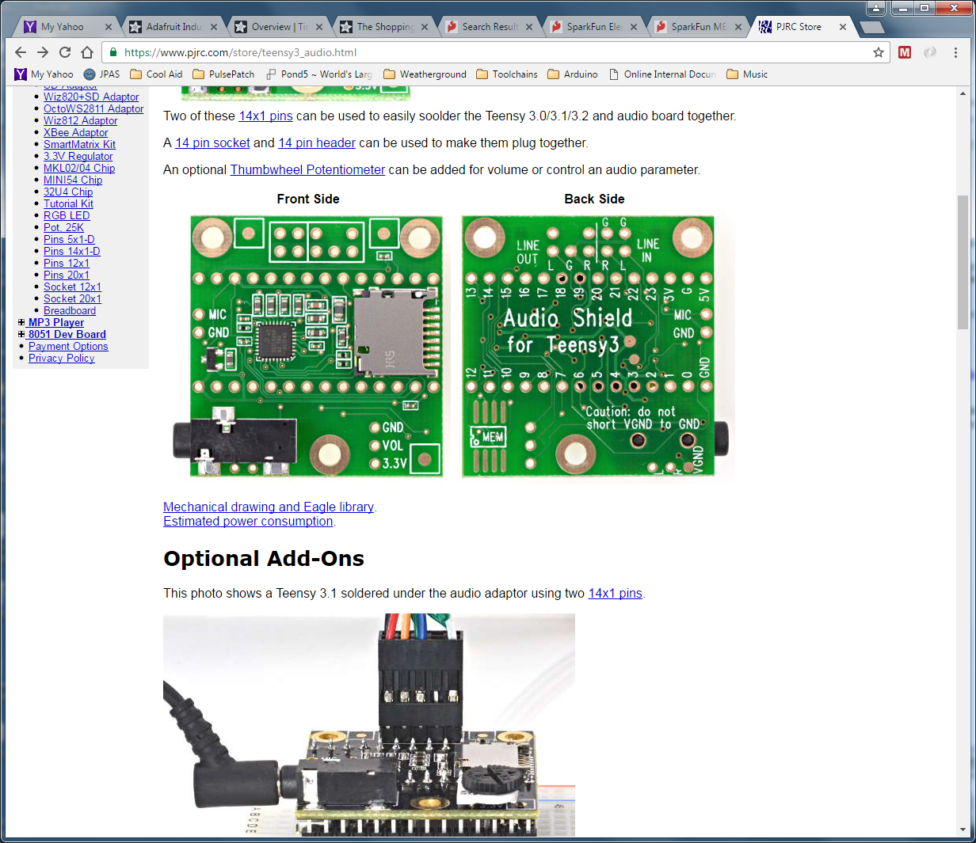
“Line In”
1/8” Phono Jack
Tip
Ring
Sleeve
“Mic In”
1/8” Phono Jack
Tip
Ring
Sleeve
Install Pot

Slide 2
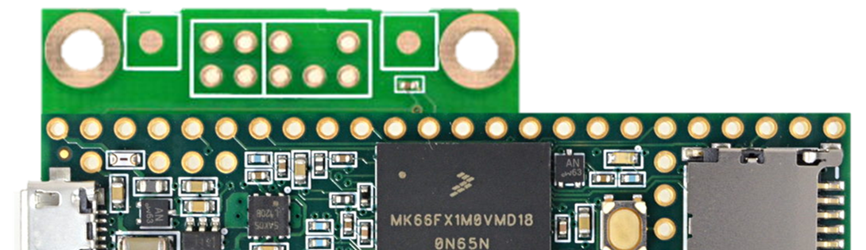
Also, grab “3V” and bring out to pin or to wire
Backside View
Add Header (Male Pins?)
To the “Line In”

Slide 3
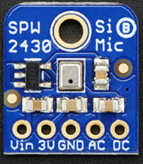
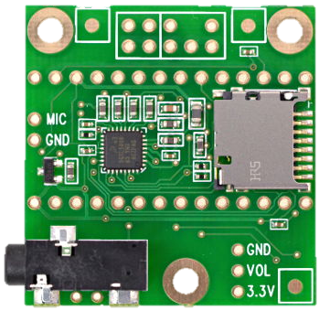

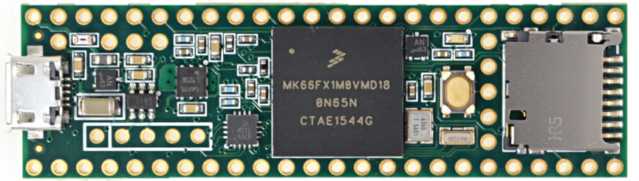
Mount Mic to the plastic base
Mount Mic to the plastic base
Mating
header
Mating
header
The new
header
Left
Right
To “Vin”
Not “3V”
Another “3V”
Wire
The “3V”
Wire
This is the plastic baseboard

Slide 4
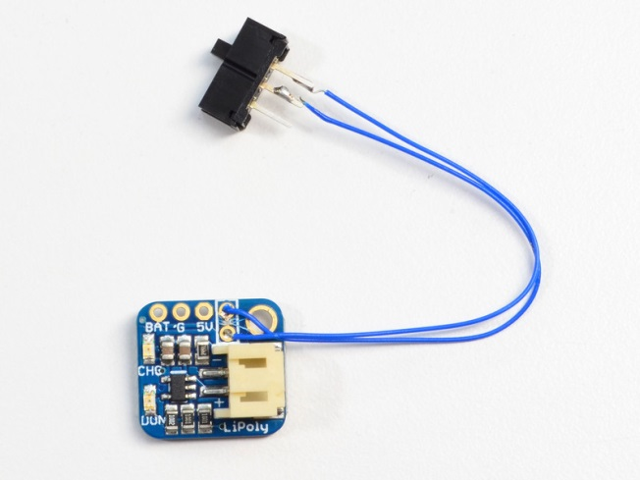
Adafruit 2124 LiPo Backpack
Power Supply
Add wires
Add a switch?
5V
Gnd

Slide 5
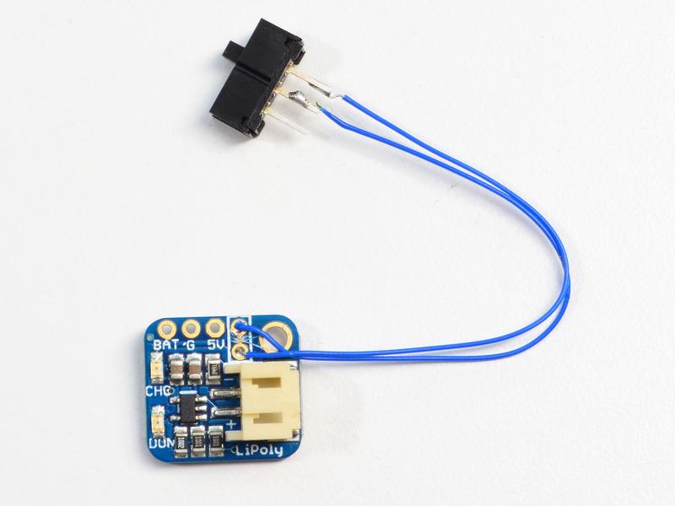
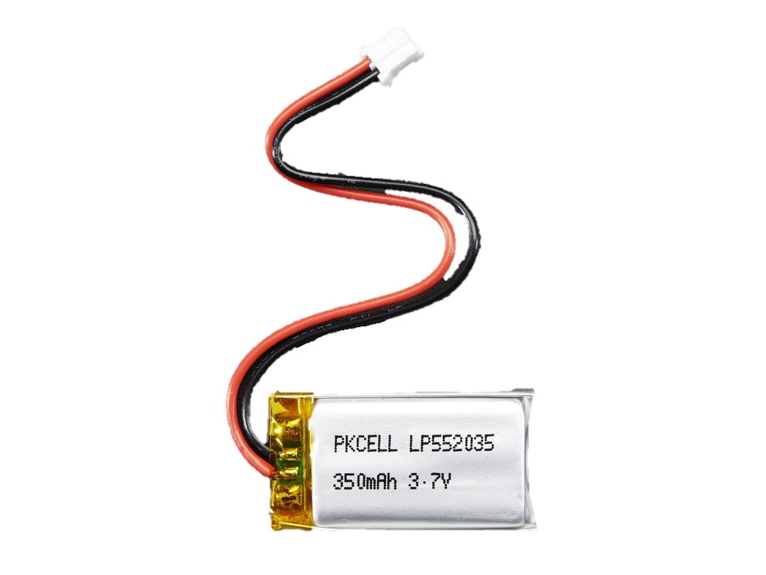
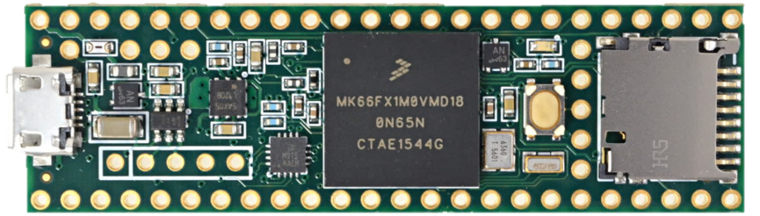
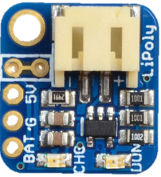
Some sort of switch.
Loose or panel mount.
Connect to 5V and
Gnd Pins underneath
Tie Down?
(Holes + ZipTie?)
Screw this down.

Slide 6
Left Mic
Right Mic
Line
In
Audio
Audio
Gnd
Gnd
3V
3V
This is the plastic baseboard

